Slide 1
THE ELECTION
Argumentative task year 9

Slide 2
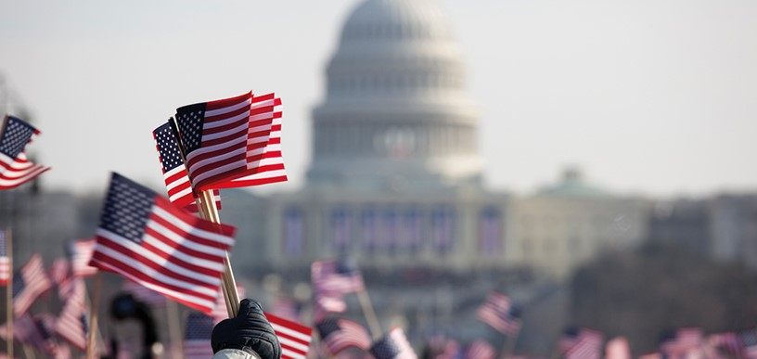
Assignment:
During a couple of weeks you´ll be working with politics and improve your argumentative skills.
In a group of three you will create your own political party, discuss for and against, decide on a party programme and make a poster for your campaign.
Then you will present your party to your class in an argumentative speech.
You will get the chance to debate with another party on a certain issue.

Slide 3
You must include:
1
Name of the party
2
Symbol of the party
3
Motto
4
Party program (which should include your main issues, but you should also decide on your politics concerning other issues)

Slide 4
Main issues; for or against/opinions
NATO - military cooperation with Europe
WHO – cooperation worldwide on healthcare matters
Death penalty
Abortion
Public health care
Immigration
The right to carry guns
Public schools – private schools
Environmental issues
Taxes
Same sex marriage

Slide 5
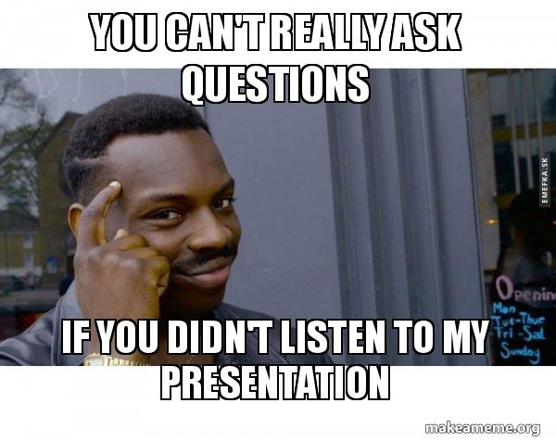
Questions?
Notes:
I bildspelsläge öppnar du länkar genom att välja pilarna.

Slide 6
Main issues; for or against/opinions

