Slide 1
Prepositions and Counting words

Slide 2
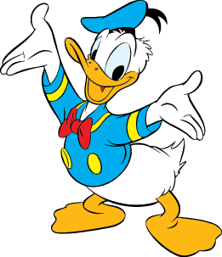
Prepositions
Words that describe where something is located for example, The cat is under the bed, To go by bus, The car is parked infront of the building.
Exampels of common prepositions: over, under, behind, infront, next to, between and by.
Timeprepositions are prepositions that describe what the clock is, or what period of time it is.
At for a PRECISE TIME
In for MONTHS, YEARS, CENTURIES and LONG PERIODS
On for DAYS and DATES
Examples: I have a meeting at 9am, in England, it often snows in December. Do you think we will go to Jupiter in the future?
Remember to use them right

Slide 3
Counting words
Counting words are words that are names of a number.
Examples, eight, two hundred ten and one hundred sixty
There are two types of counting words
The first one is cardinal number is the amount of something for example five, ten and twenty
More examples:
I got twenty cars in my garage
My friend got two cats
"Order numbers" are words that are the names of a place in an order.
For exampel, ”Usain Bolt came first place in the 100m race.”

