Slide 1
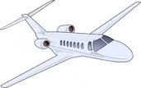
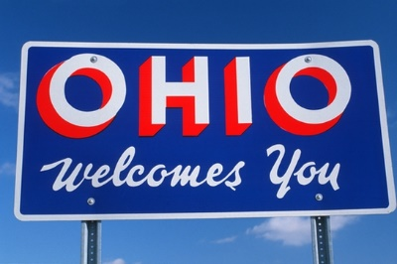
MY TRIP TO OHIO
2016

Slide 2
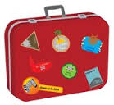
GOING TO CLEVELAND 8 MAJ
16:35 - 18:35 | SK945 | Stockholm, Arlanda (Terminal 5) - Chicago, O Hare International (Terminal 5)
21:15 - 23:33 | UA1155 | Chicago, O Hare International (Terminal 1) - Cleveland
LEAVING CLEVELAND 15 MAJ
18:15 - 18:44 | AA3188* | Cleveland - Chicago, O Hare International (Terminal 3)
21:05 - 12:30 | SK946 | Chicago, O Hare International (Terminal 5) - Stockholm, Arlanda (Terminal 5)

Slide 3
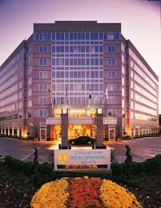
HOTEL
Intercontinental Hotel Cleveland

Slide 4
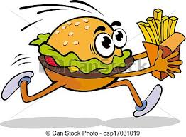
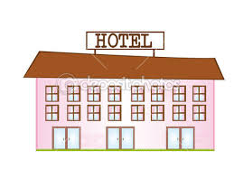
MY BUDGET
FLYINGTICKETS – 9768 KR HOTEL – 16 863 KR ACTIVITIES – 1 500 KR FOOD – 3 500 KR TRANSPORTATION – 6 500 KR SHOPPING – 4 000 KR TOTAL – 34 431 KR

Slide 5
FACTS ABOUT OHIO
Ohio is a state in the USA. Ohio’s capital is Colombus. Ohio’s motto is ’’With God all things are possible’’ So I guess they are very religious. Their state symbols are: Flower – Scarlet Carnation (1904) Tree – Buckeye (1953) Bird – Cardinal (1933) Insect – Ladybug (1975) Gemstone – Flint (1965) Song – Beautiful Ohio (1969) Beverage – Tomato Jucie (1965) Fossil – Trilotibe (1985) Animal – White tiled deer (1988) Wildflower – Large white trillium (1987)
Ohio’s nickname is ’’Buckeye State’’. Neil Armstrong and Paul Newman is two famous people from Ohio. The state song of Ohio is ’’Beautiful Ohio’’ https://www.youtube.com/watch?v=xO9a5KAtmTM

Slide 6
EXCURSIONS TO DO IN OHIO
King Island (Mason, Ohio) Rock and Roll hall of fame and museum (Cleveland, Ohio) Ohio state reformatory (Mansfield, Ohio) National Museum of the United States (Dayton, Ohio) Cleveland museum of art (Cleveland, Ohio)

Slide 7
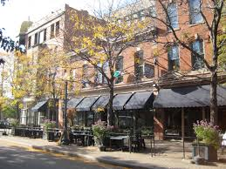
MY FIRST DAY IN OHIO
Hi Marianne! Today I’m flying to Cleveland, Ohio. I am very exited because it’s my first time in Ohio. I’m flying from Arlanda to Chicago and then I’m flying to Cleveland. When I first arrive to Cleveland I’m going to check in to my hotel wich is a really nice hotel and drop of all of my bags. Then I’m going to rent a car so that I don’t have to take the bus or the train. Because I think the car is much easier. I’m not going to do any activites on my first day, because I’m probably going to be very tired and I want to have a lot of energy tomorrow when I’m going to Rock And Roll Hall Of Fame And Museum.

Slide 8
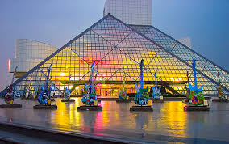
My first excursion in Ohio
Hello Marianne! Today I was at the Rock And Roll Hall Of Fame And Museum, I didn’t really know what to expect but It was really fun. I took the car to 1100 E 9th Street in Cleveland. The hall of fame and museum was in a really big and beautiful building. I saw a lot of cool guitarrs and I learned a lot of stuff about rock stars. This was a different kind of excursion for me, because I’m not that into rock and roll and I don’t listen to that kind of music. But I talked to a friend that recommended that I should go and check it out. And I can really see why she recommended it! This was a really fun day in Ohio, and I can’t wait until tomorrow when I am going to King Island!

Slide 9
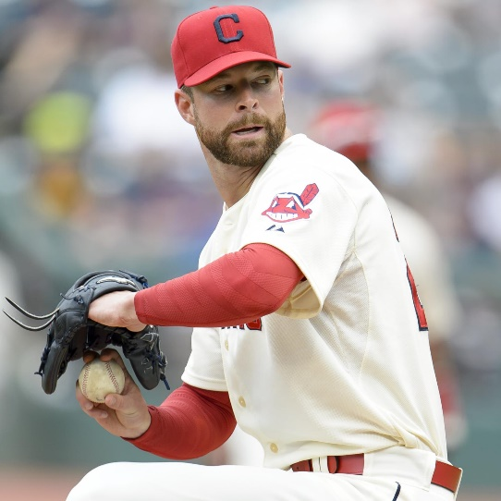
BASEBALL
Hi Marianne! Today I did a really fun thing, I went to my first baseball game with a friend i found here in Ohio. We cheered for the Cleveland team, Cleveland Indians. It is kind of like the swedish brännboll but it is a lot more serious here in the USA. In baseball you have a pitcher, infielder, outfielder, first baseman etc. Infielders are the ones that run around the field and the outfielders are the ones that are supposed to catch the baseball. The pitcher in Cleveland Indians is named Corey Kluber, he’s pretty famous.

Slide 10
TIME TO GO HOME
It has been really fun visiting Ohio, and I would very much like to come back some day! But now it’s time to head back to Sweden, I will really miss it here. I’ve met so much great people. I can really recommend that those who visit Ohio check out the Ohio State Reformatory. It’s a ghost house and it is really scary and very beliveable. Since I’m very into spirits, ghost and haunted things I really thought this was a good ghost house. And the hotel I stayed at was a pretty good hotel, the internet was a little bit slow but besides that It was all good. And it is a little bit expencive but it was a good hotel so it was worth it. And the breakfast is delicious! BYE OHIO, I’LL BE BACK!

