Slide 1
Pronouns

Slide 2
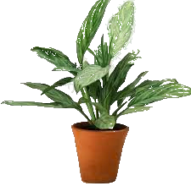
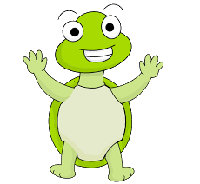
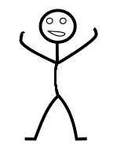
What is a pronoun?
Pronoun is words you say instead of nouns.
Exampels of nouns, an animal a plant or a person.
Examples:
The table – it
The woman – she
Tora and Johanna – them
Notes:
Pronoun is words you say instead of nouns to make the language more complex and developed. Different types of pronouns does different types of things in a text.
For example an animal a plant or a person.

Slide 3
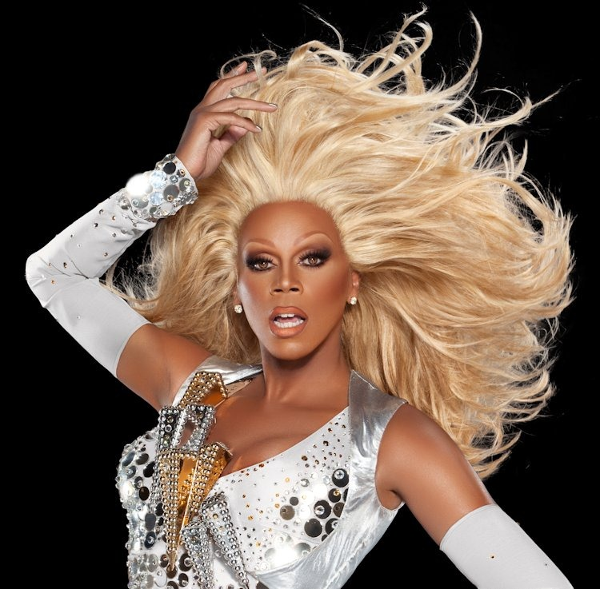
Personal pronouns
In today`s society you can find different kinds of stereotypes about each other's personal pronouns.
The most common mistake is that you use he or she at someone based on their clothes or what they like.
Example.....

Slide 4
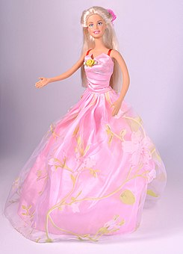
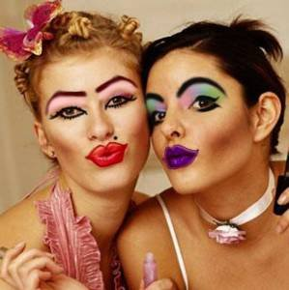
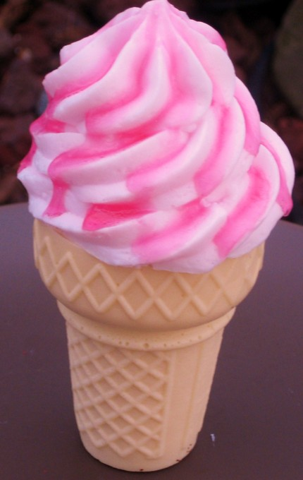
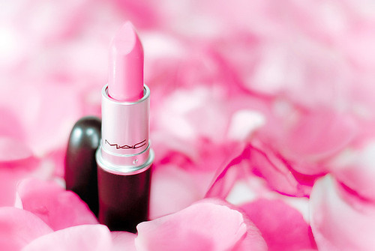
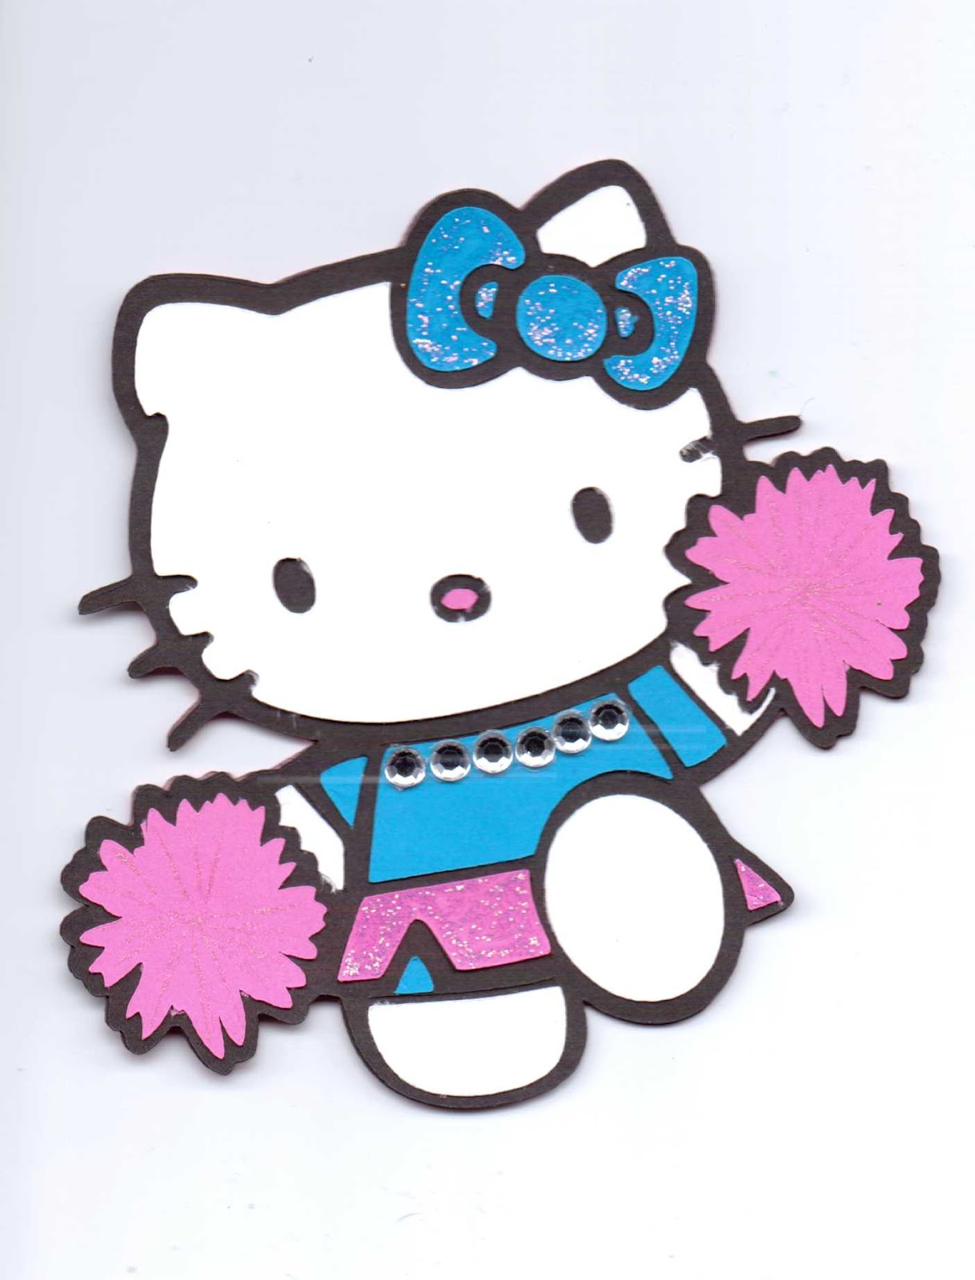

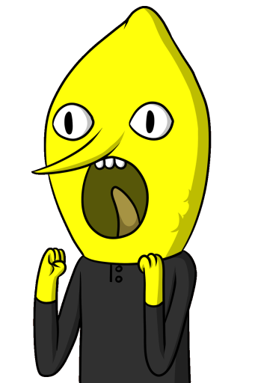
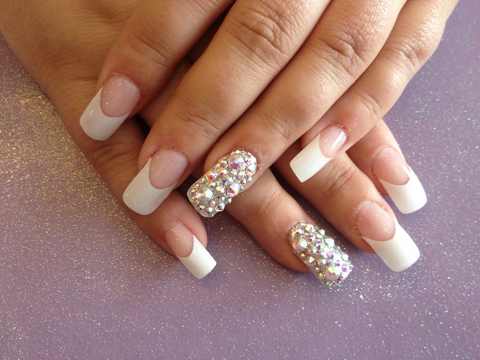
Det här fotot av Okänd författare är licensierat enligt CC BY-NC-ND.
Det här fotot av Okänd författare är licensierat enligt CC BY-SA-NC.
Det här fotot av Okänd författare är licensierat enligt CC BY.
Det här fotot av Okänd författare censinligt CC BY-SA.
Det här fotot av Okänd författare är licensierat enligt CC BY-ND.
Det här fotot av Okänd författare är licensierat enligt CC BY.
Det här fotot av Okä
Det här fotot av Okänd författare är licensierat enligt CC BY-SA-NC.

Slide 5
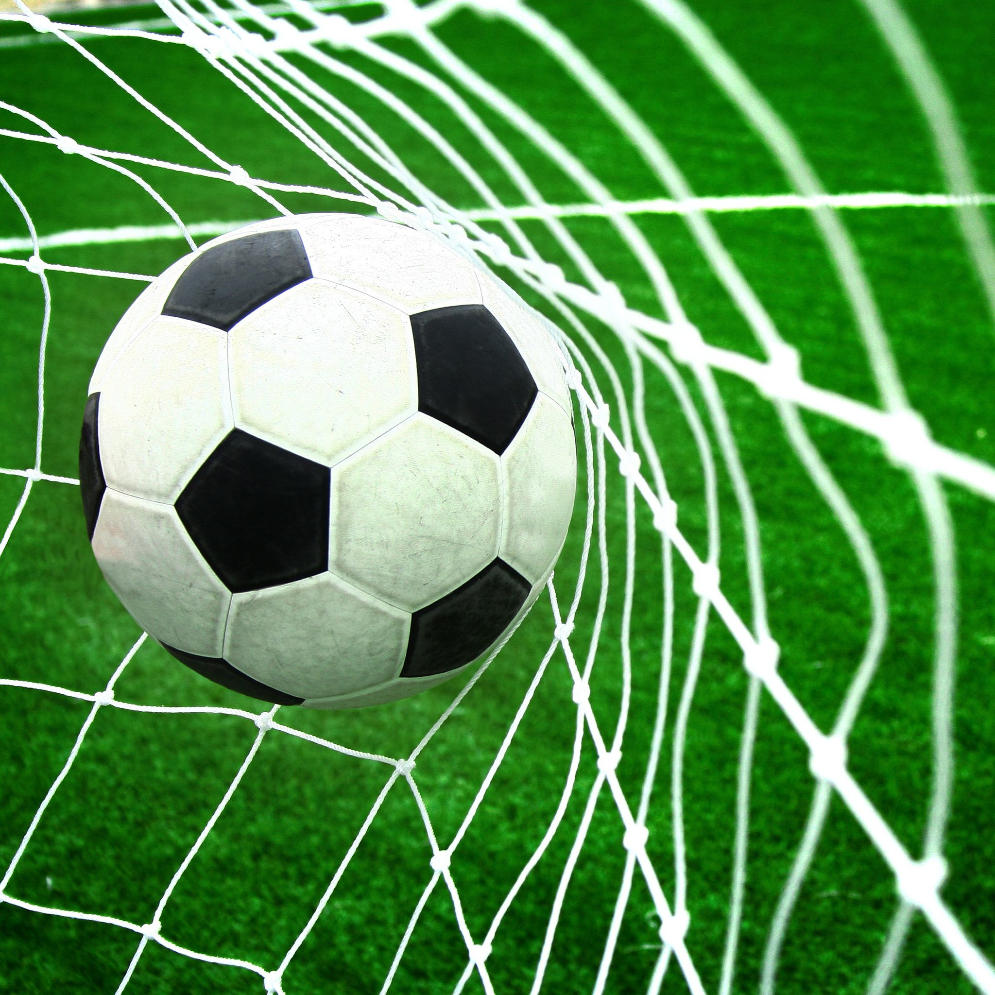
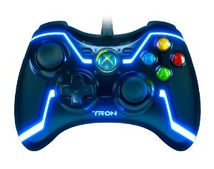

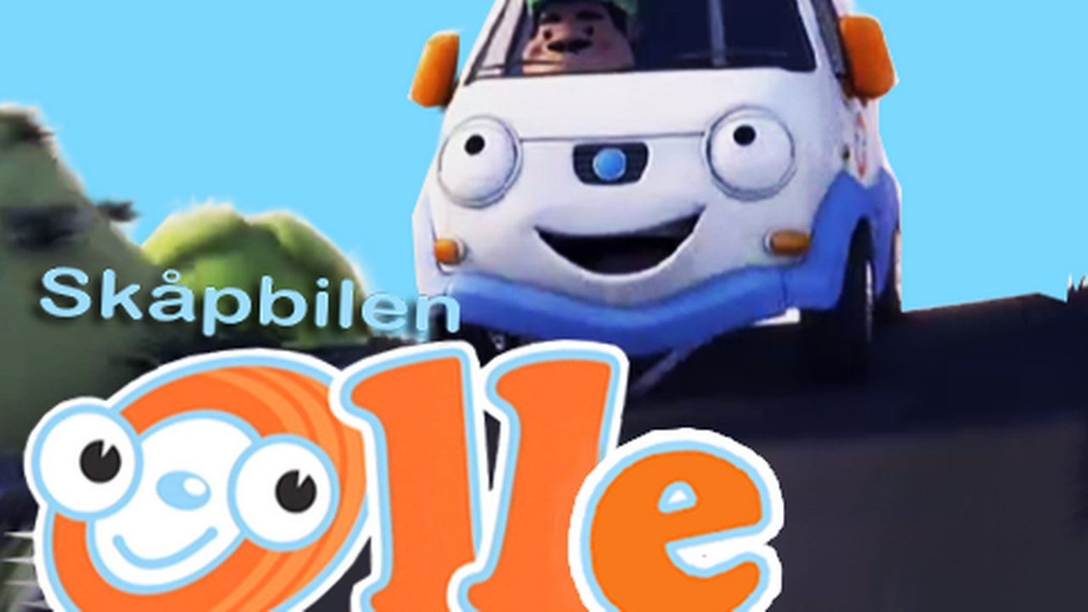
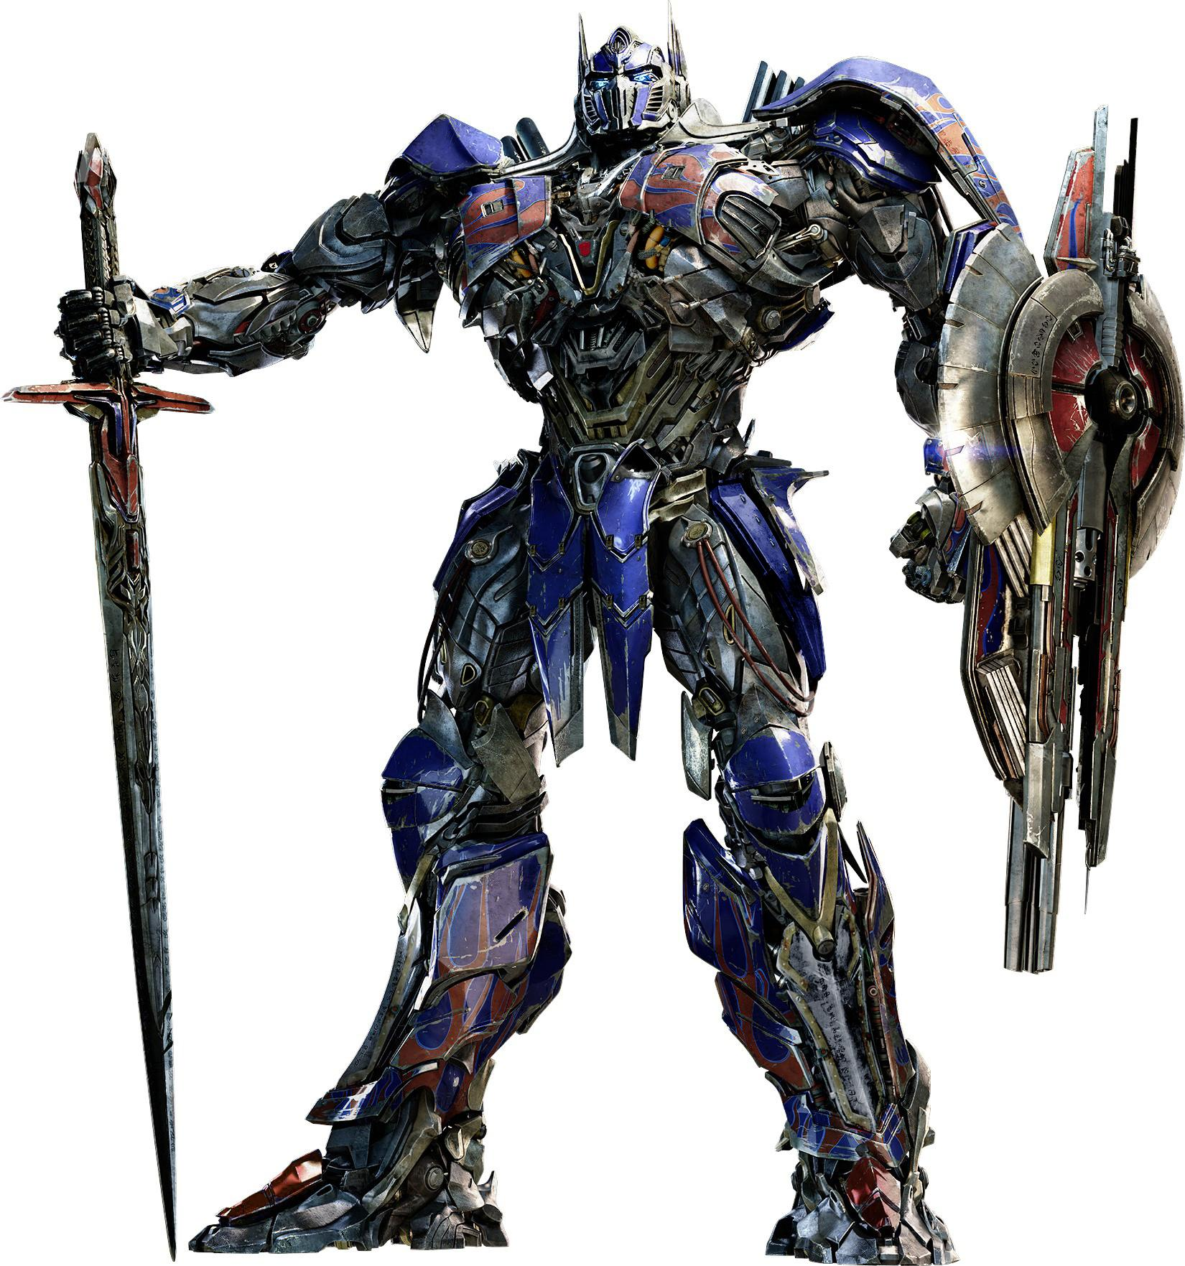
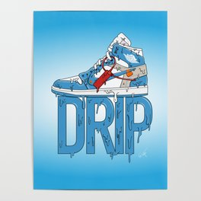
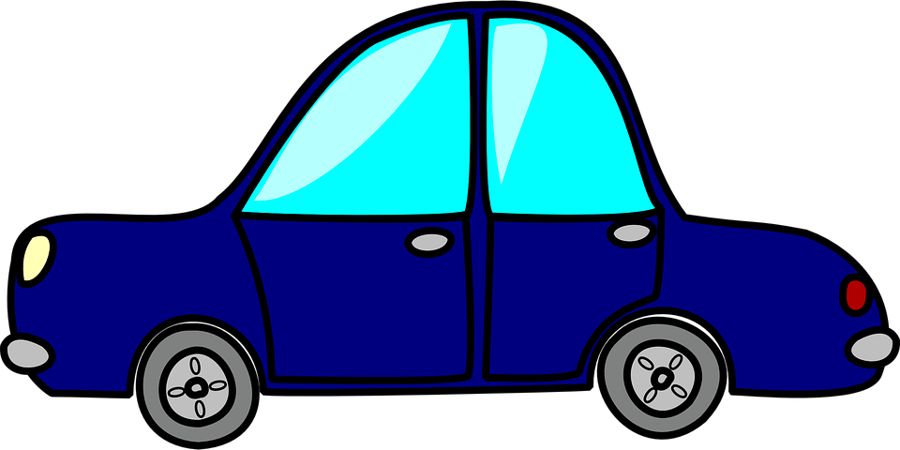
Every one likes a white van, am i right or am i right?
Det här fotot av Okänd författare är licensierat enligt CC BY-SA.
Det här fotot av Okänd författare är licensierat enligt CC BY.
Det här fotot av Okänd författare är licensierat enligt CC BY.
Det här fotot av Okänd författare är licensierat enligt CC BY-SA-NC.

Slide 6
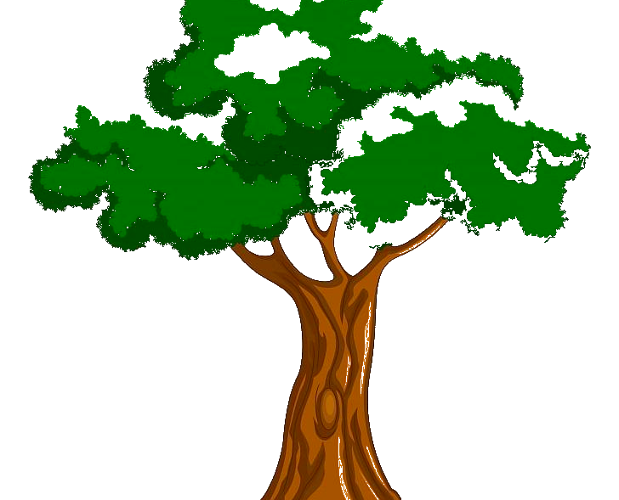
So why do we have to use pronouns?
Look at this example:
Tora likes to climb trees and Tora does it every day.
Tora likes to climb trees and she does it every day.
The only change in that short scents was the pronoun and yet we can see that it already looks more professional when we use the pronoun.
Notes:
When you are writing a text you want it to have a flow that you don’t get when you repeat yourself over and over. Look at this simple sentence for instance:
The only change in that short scents was the pronoun and yet we can see that it already looks more professional and less weird when we use the pronoun.

Slide 7
Pronouns forms
Personal pronouns
Possessive pronouns
Reflexsive pronouns
Determinative pronouns
Demostrative pronouns
Gender-neutral pronouns
Interrogative pronouns
Relative pronouns
Indefinite pronouns
Reciprocal pronouns
There’s a lot of different forms of pronouns that we use in different occasions, to develop the English language. We can't go
through them all today but here they are if you want to look a bit closer later.
Notes:
There’s a lot of different forms of pronouns that we use in different occasions to develop the english language. We can't go
through them all today but here they are if you want to look a bit closer later.

Slide 8
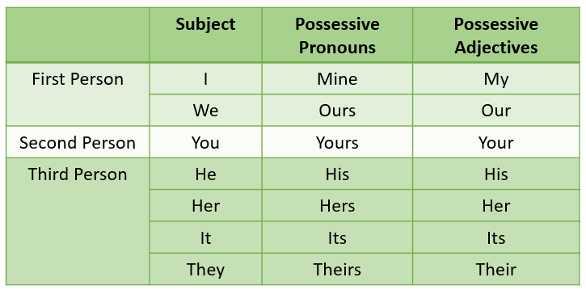
Possessive pronouns
That apple is my apple not your apple. Blue- possessive adjectives
That apple is mine not yours. Green- possessive pronouns
To possess- to own
Notes:
Possessive pronouns is about the words that describes who owns what. You use them instead of nouns but also possessive adjectives as you can see on the chart. Here is a similar example to the one before. The first sentence is correct but is unnatural because we are repeating the noun. In the second sentence we use possessive pronouns instead and that sentence is more natural.

