Slide 1
There is / there are
There is and there are means that something exists.

Slide 2
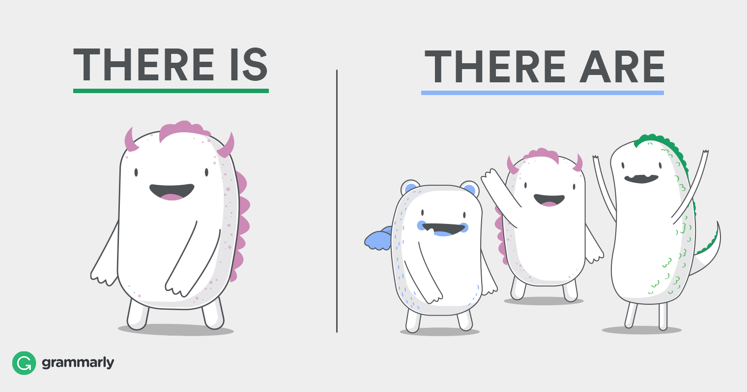
When do you use it?
There is for singular (one)
There are for plural (multiple)
Example's
1. There is a bee on me.
2. There is a car in my driveway.
3. Is there a boy in the room?
Example's
1. There are five apples in my basket.
2. There are many people at my house.
3. Are there any lions at the zoo?

Slide 3
The Contractions of there is
The contraction of there is, is there's.
(It saves time when writing)
There's a good song on the radio.
There's only one chocolate left in the box.

Slide 4
Negative form - there is / there are
Positive
Negative
There is a car. | There isn't a car.
There are four cars. | There aren't four cars.
Singular
Plural

Slide 5
Uncountable nouns
Tea​ | Love ​ | Fear ​ | Sugar​ | Rice ​ | Evidence​ | Water ​ | Money ​
Examples:
When to use:
Uncountable nouns are for the things that we cannot count with numbers

Slide 6
Negative form
The negative is formed by putting not after is or are:
There is not a horse in the field.
There are not eight children in the school.
There aren't with ANY
When we want to indicate that a zero amount of something, we use there aren't any.
There aren't any people at the party.
There aren't any trees in my street.
We also use this structure with uncountable nouns:
There isn't any water in the swimming pool.
There isn't any sugar in my coffee.

Slide 7
Sources
Grammar
https://www.grammar.cl/Present/ThereIsThereAre.htm 16/1-20
https://first-english.org/english_learning/english_beginners/there_is_there_are/00_there_is_there_arel_grammar_rules.htm
https://www.ef.com/ca/english-resources/english-grammar/countable-and-uncountable-nouns/ 27/1-20
Photos
https://www.google.com/imgres?imgurl=https%3A%2F%2Fcontenthub-static.grammarly.com%2Fblog%2Fwp-content%2Fuploads%2F2016%2F11%2FTHERE-IS-THERE-ARE.jpg&imgrefurl=https%3A%2F%2Fwww.grammarly.com%2Fblog%2Fthere-is-there-are%2F&docid=ChYu_ottNtWYUM&tbnid=DyVEdcK6yfxBFM%3A&vet=10ahUKEwjakeSZ7ofnAhUCxYsKHRhhDx8QMwhOKAMwAw..i&w=1520&h=800&bih=610&biw=1280&q=there%20are%20there%20is&ved=0ahUKEwjakeSZ7ofnAhUCxYsKHRhhDx8QMwhOKAMwAw&iact=mrc&uact=8
By: Sigrid Santesson and Emilie Des Rosiers

