Slide 1
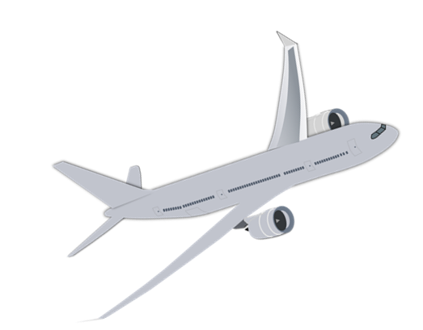
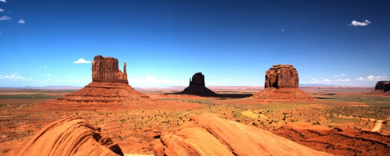
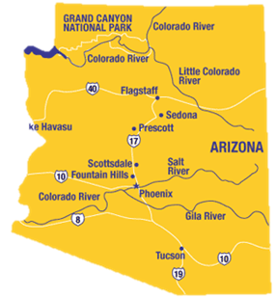
A WEEK IN ARIZONA
JUly 31 TO august 7

Slide 2
FACTS ABOUT ARIZONA
Arizona is a state in the southwestwern part of USA and the capital is Phoenix.
7 millions inhabitants in the country.
Arizonas area is almost half as big as Swedens area.
In northern arizona there´s some mountain peaks that´s called the ”Snowbowl”, where you can actually ski in the winter.
The country is very known for their big and very beautiful national park Grand Canyon, it´s more than 1 billion years old.
Two of the biggest man-made lakes are placed in Arizona.
A brige that you today can find in Arizona, over the Havasu City Lake, before stood in London. But in 1960 it was shipped all the way to Arizona, stone by stone. There they built it up again.
Arizona entered the country as the 48th state of the USA, on the 14th of feburary 1912.

Slide 3
BUDGET FOR MY TRIP
Flighttickets
Hotel
Transport
Food
Shopping
Activities
Extra
Total
-
-
-
-
-
-
-
-
8 467
3 448
3 000
3 000
3 500
2 074
1 000
24 489

Slide 4
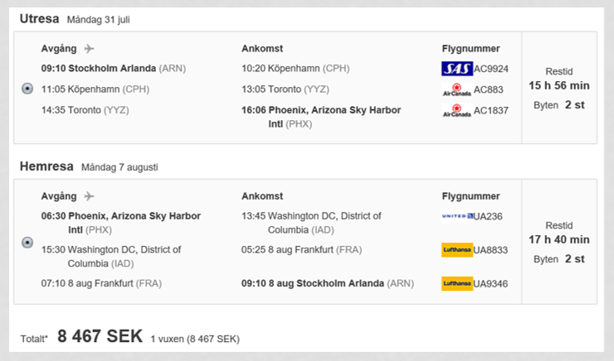

Slide 5
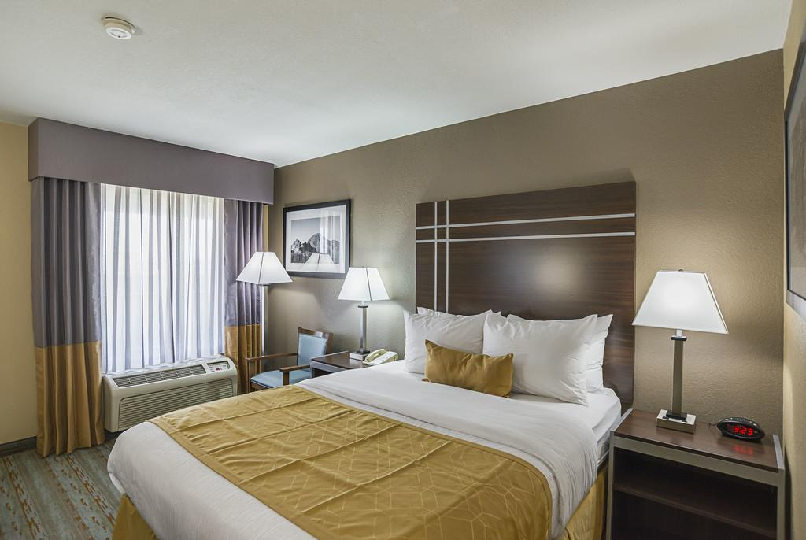
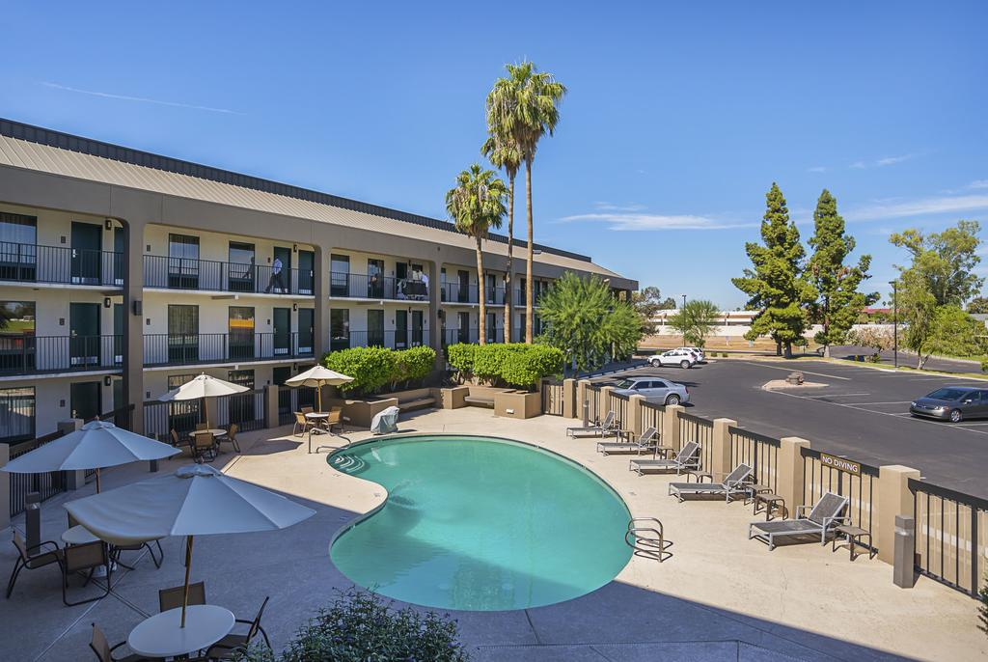
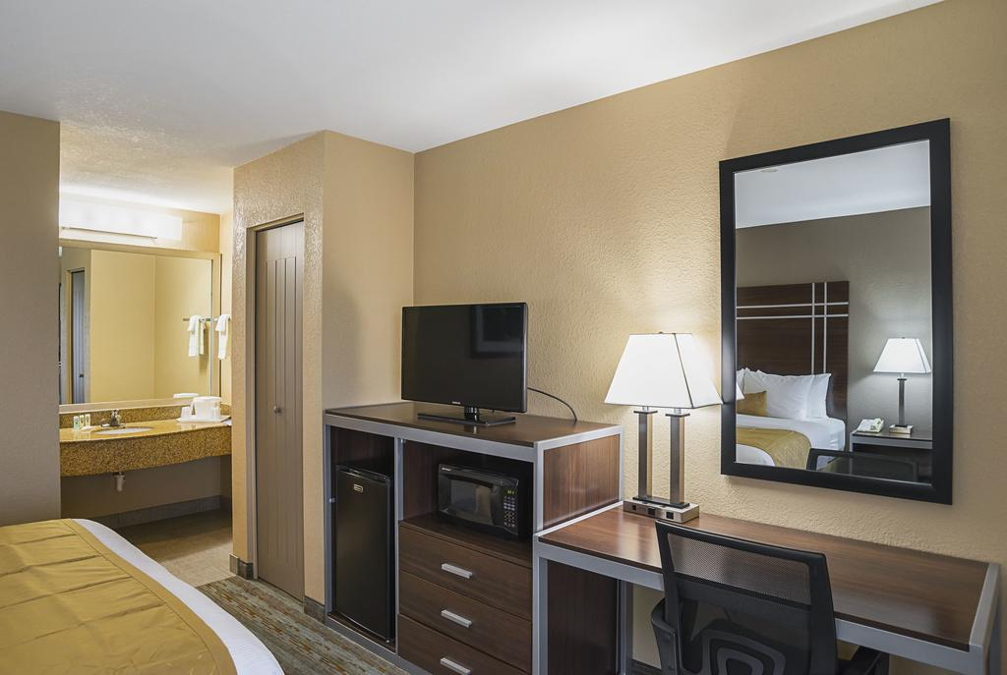
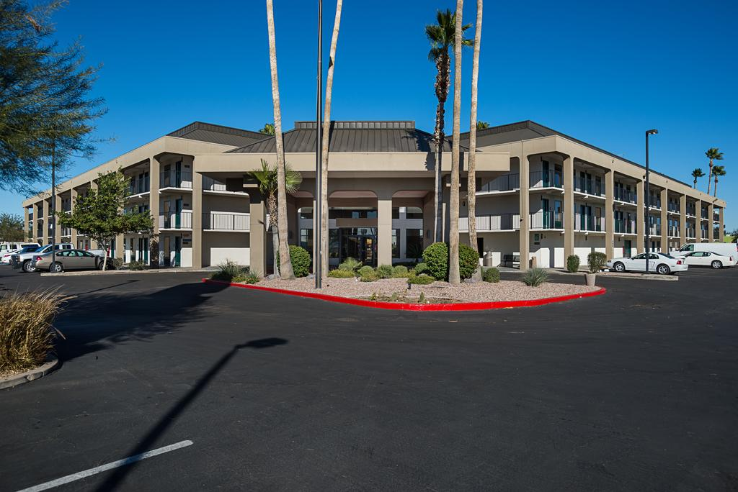
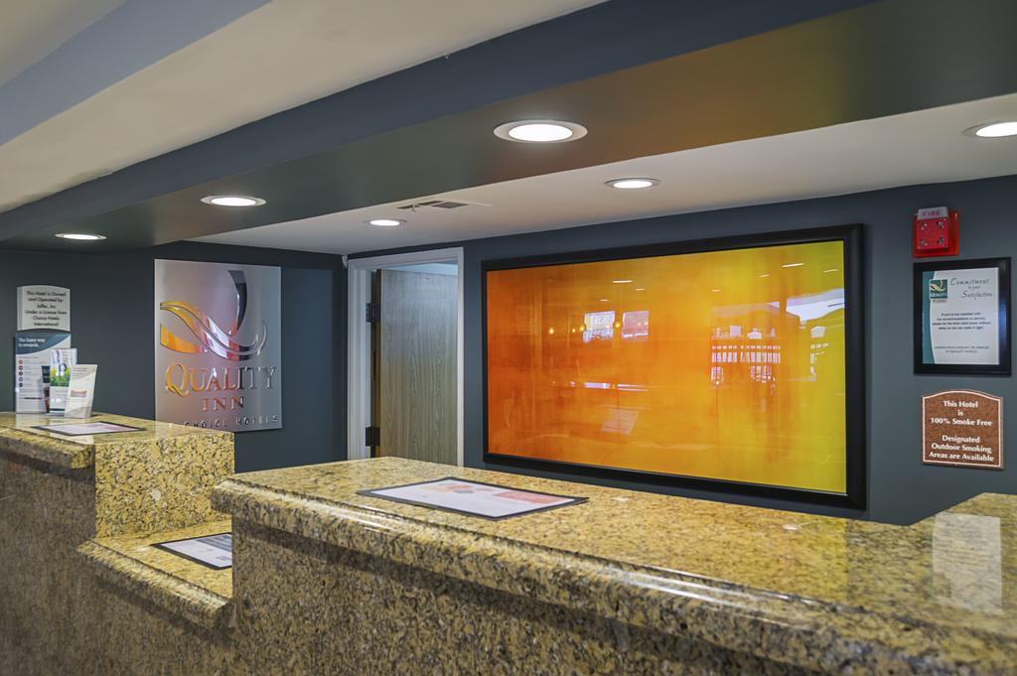
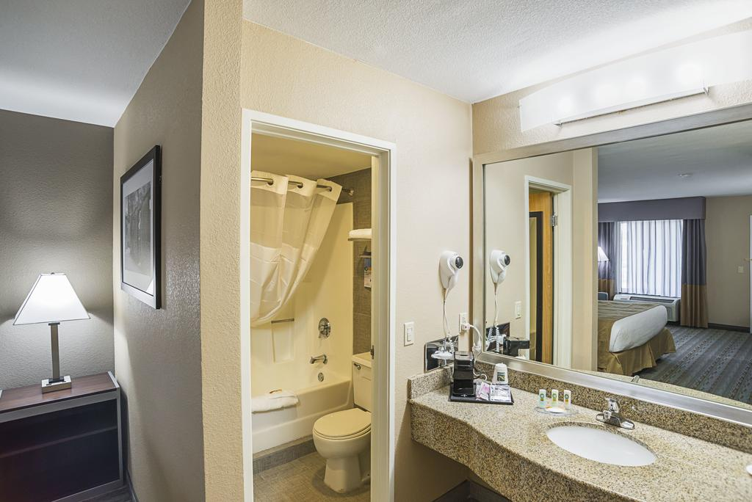
QUALITY INN PHOENIX

Slide 6
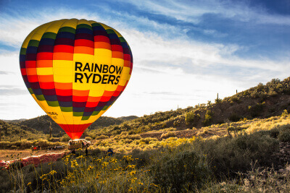
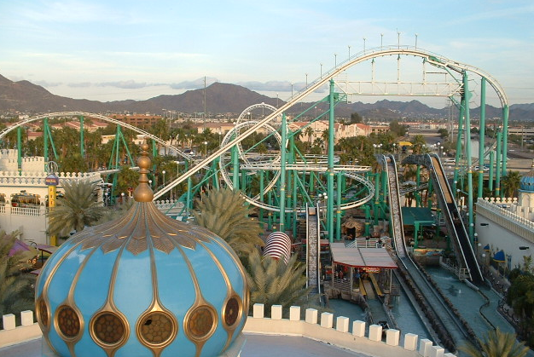
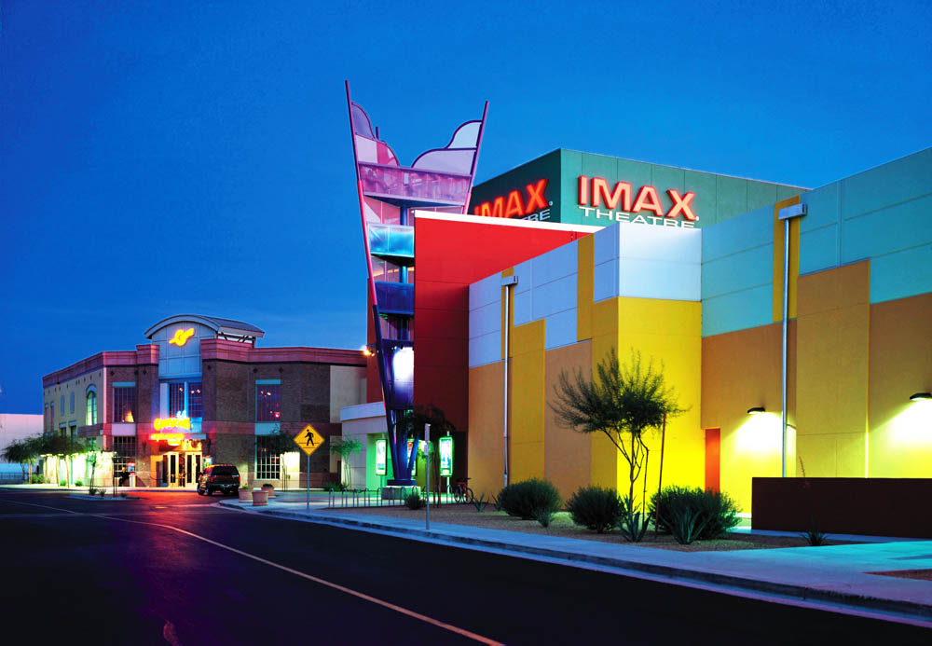
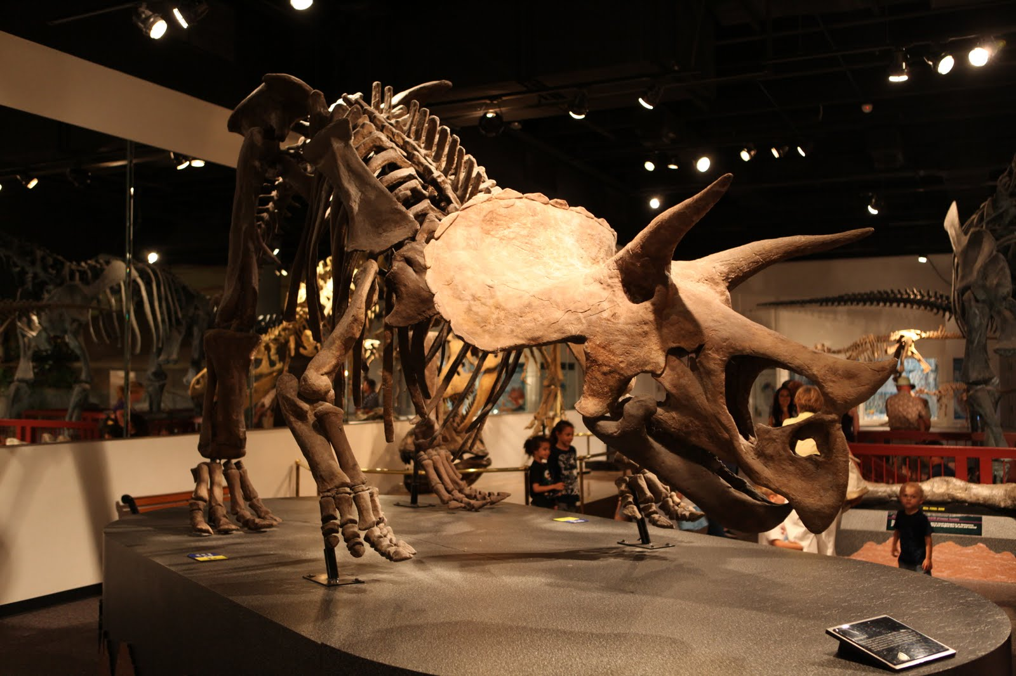
EXCURSIONS IN ARIZONA
Sunrise Balloon Rides in Phoenix – 1607 kr
Castles n´ coasters -360 kr
Arizona museum of Natural History – 107 kr
Arizona Mills

Slide 7
Hello Marianne!
Today it´s my third day here in arizona. The same day as we arrived here and got to our hotel I almost did nothing. I just ate dinner at the hotel and later I fell asleep. The next day I just relaxed at the hotel by the pool with my friend, that I am travelling with. It was nice to just be here on the hotel the firts day and not do so much, I was kind of tired from the day before. But then, after we ate, we planned for tomorrow. And we decided that tomorrow, we are going to the Natural History museum of Arizona. The weather isn´t going to be so good tomorrow, so I thought that was the right thing to do then. I´m so excited and I think it´s going to be a lot of fun.
Marianne Othman Häggqvist
Valsätraskolan
756 47, Uppsala

Slide 8
Hi Marianne,
today it´s thursday and today it was our fourth day here. As I said last time we planned to visit the museum today, we also did. First when we came there we paid for the entrance, and we also paid a little bit extra for a guided tour around the museum. The guide showed us and talked about what our planet looked like million years ago. It was very interesting to see and learn more about the dinosaurs and other animals that lived on the planet for so many years ago. It was fun but tomorrow I think it´s going to be even funnier, because then we´re going to the fun park, Castles n´ Coasters. And the day after that, we´re going to do our last excursions. Go to the shopping mall and then fly in a hot air balloon.
Marianne Othman Häggqvist
Valsätraskolan
756 47, Uppsala

Slide 9
Hello Marianne
Now a couple of days have passed and we´re going home soon. So on the Friday we was at the funpark, there we rode the rollercoasters and played some minigames. We also swam in the pool at the end of the day and we went on some waterslides too.
The next day we just was at the hotel all day. But then on the Sunday, our last full day here, we went to the mall in the forenoon. Then on the afternoon we did our last excursion. We watched the sunset from a hot air balloon. That was just so amazing and beautiful.
Tomorrow is our last day here and we´re going to the airport very early in the morning. Then we will go back to Sweden again.
From Ingrid
Marianne Othman Häggqvist
Valsätraskolan
756 47, Uppsala

Slide 10
So that was it for this time. I had a very great
time there and I can promise that this was not the last time I went to Arizona. I would truly recommend you to travel there sometime. It´s really beautiful there and there´s a lot of great excursions to do while you´re there.

Slide 11
SOURCES
https://www.rainbowryders.com/hot-air-balloon-rides-phoenix/
http://arizonamuseumofnaturalhistory.org/plan-a-visit
https://secure.booking.com/book.html?from_source=hotel&hotel_id=47639&aid=310018&label=us-phoenix-qAcBOV13rxeBNluKdSr3fQS107056865110%3Apl%3Ata%3Ap1180%3Ap2%3Aac%3Aap1t1%3Aneg%3Afi%3Atikwd-138740636%3Alp9062483%3Ali%3Adec%3Adm&sid=86cb745eea47e2e299d6f11adbfc7f23&room1=A&error_url=%2Fhotel%2Fus%2Fbest-western-metro-center-inn.sv.html%3Faid%3D310018%3Blabel%3Dus-phoenix-qAcBOV13rxeBNluKdSr3fQS107056865110%253Apl%253Ata%253Ap1180%253Ap2%253Aac%253Aap1t1%253Aneg%253Afi%253Atikwd-138740636%253Alp9062483%253Ali%253Adec%253Adm%3Bsid%3D86cb745eea47e2e299d6f11adbfc7f23%3B&hostname=www.booking.com&stage=1&checkin=2017-07-30&interval=8&children_extrabeds=&nr_rooms_4763920_94269960_2_1_0=1&rt_pos_selected=1
http://ohfact.com/interesting-facts-about-arizona/
https://www.arizonasnowbowl.com/?q=node/56
http://castlesncoasters.pfestore.com/retail/tickets/Default.aspx
http://www.onlyinyourstate.com/arizona/az-favorite-food-and-drinks/
http://www.wisegeek.org/what-is-menudo.htm
http://www.encyclopedia.com/places/united-states-and-canada/us-political-geography/arizona
http://mapfight.appspot.com/us.az-vs-se/arizona-us-sweden-size-comparison
http://worldpopulationreview.com/states/arizona-population/

